Slide 1

Team | ORAI
Speaker | Yu Jae Sang

Slide 2
1. Team Introduction
Team | ORAI (OR with AI)
Research Topic | (Korean) … AI를 활용한 전기차 충전소 최적화 프로젝트
 | (English) … Optimizing the electric vehicles charging station with AI
Professor | 권상진 교수님 |  |  | Dept. | 산업공학
TA | 조수경 TA |  |  | Dept. | 산업공학
Team Members |  | Name | Dept. |  | Role
 | 1 | 유재상 | 전기전자공학 |  | Team leader
 | 2 | (transfer)임가은 | 경영공학 |  | 논문 담당
 | 3 | 복영규 | 경영공학 |  | Data 수집
 | 4 | (new)이주헌 | 디자인 및 인간공학 |  | 논문 담당
 | 5 | (new)김동현 | 경영공학 |  | Data 분석
 | 6

Slide 3


2. Purpose and Goals
Feel free to change the format and/or add more pages to highlight your contents. (자유롭게 양식 수정, 페이지 추가)
Research Background (연구 배경)
Research Purpose (연구 목적)
기존의 최적화 기법의 한계
Research Goals (연구 목표)
Research Expectations (기대 효과)
AI를 활용한 보안
및
global optimum 도출
전기차 충전소 문제 뿐만 아닌 다양한 MCLP에 적용가능

Slide 4
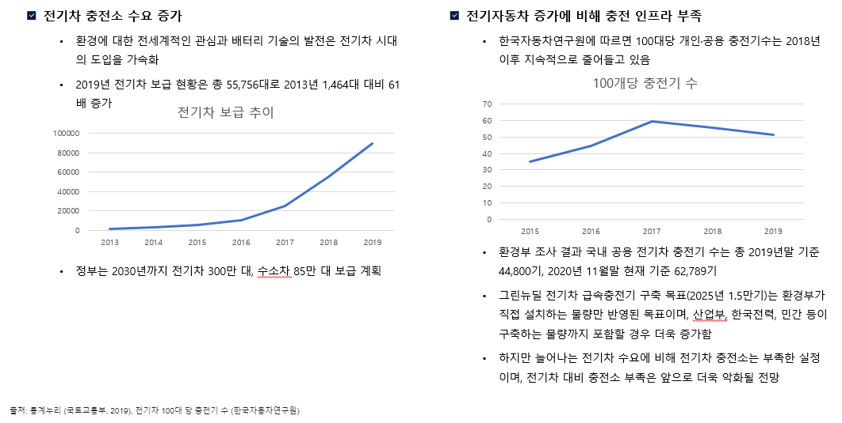
Research background

Slide 5
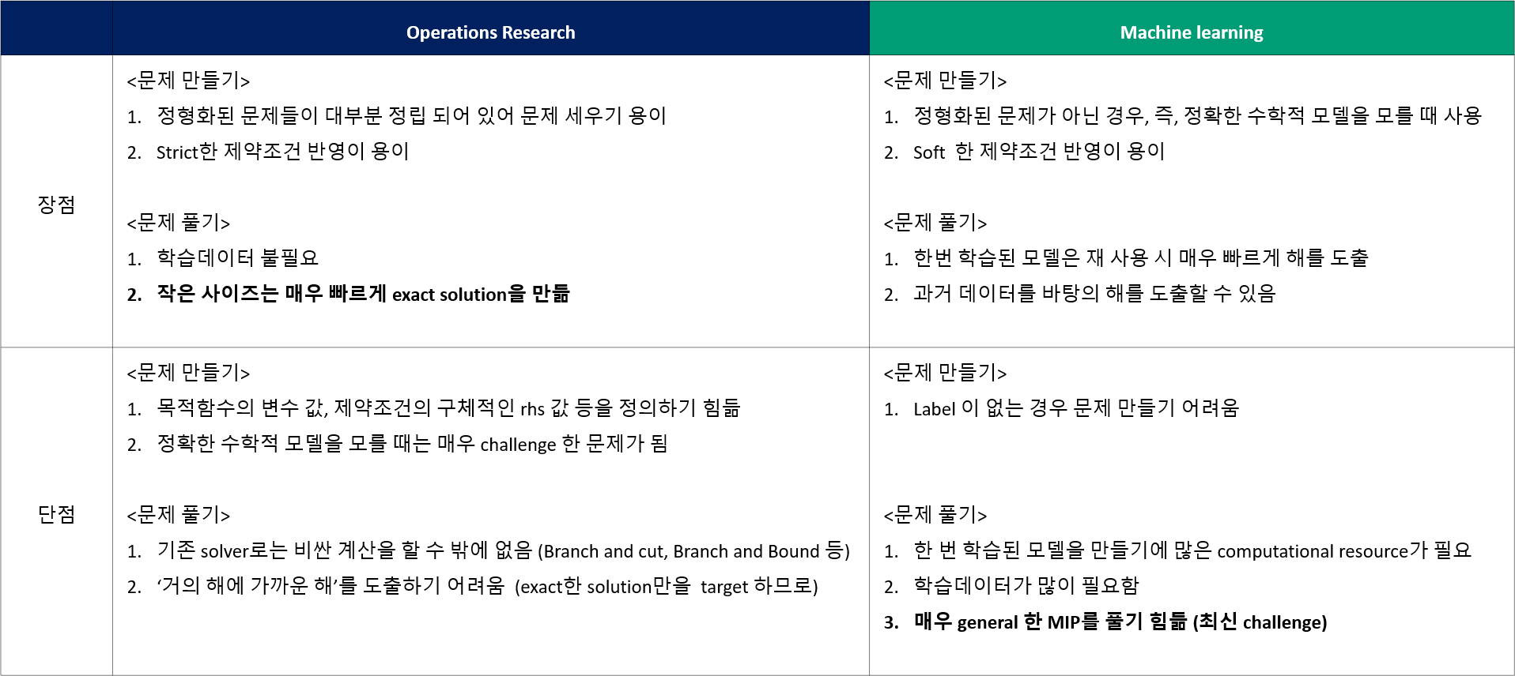
OR vs ML

Slide 6
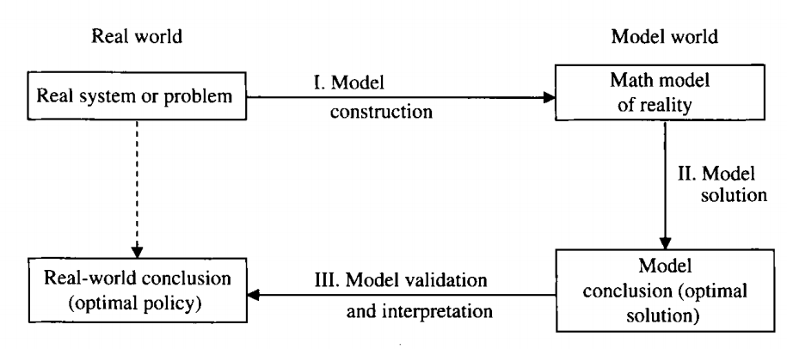
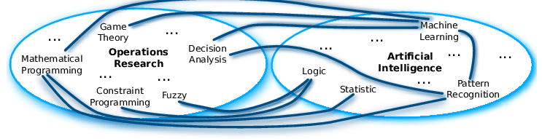
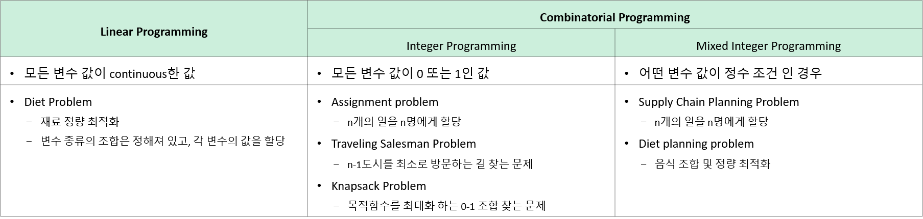
Operations Research
Overview
ML
ML

Slide 7
How to solve?
Branch and X ¹⁾
Branch and Bound
Branch and Cut
Branch and Price
Exact method
Constraint Programming
Constraint propagation
Solver
(CPLEX, Coin-OR-CBC,...)
Dynamic Programming
Subproblem
master-problem
Optimization method
Metaheuristics
Genetic Algorithm
Ant Colony Optimization
Tabu search
Approximation Algorithm
Approximate method
Rounding heuristic
Diving heuristic
Sub-MIP heuristic
Feasible Pump
Matheheuristics
Heuristic Algorithm
Problem-specific heuristics

Slide 8
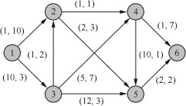
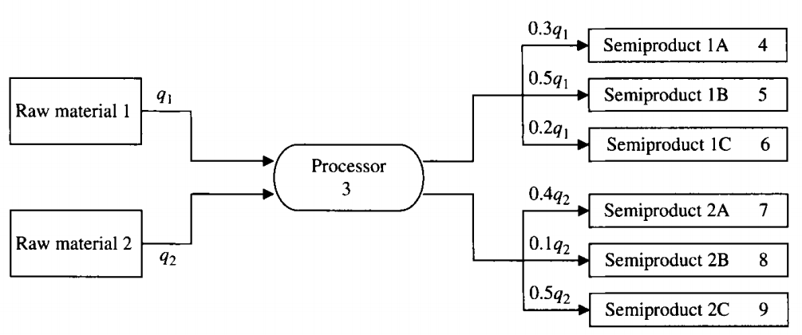
More Examples of Combinatorial Programming
PROJECT SELECTION PROBLEMS
: 프로젝트 선정 모형
PRODUCTION PLANNING PROBLEMS
: 생산계획 문제
WORKFORCE/STAFF SCHEDULING PROBLEMS
: 노동/작업 계획 문제
Knapsack Problem
Uncapacitated Lot Sizing
Capital Budgeting Problem
Capacitated Lot Sizing
Scheduling Full-Time Workers
Just-in-Time Production Planning
Scheduling Full-Time and Part-Time Workers
FIXED-CHARGE TRANSPORTATION AND DISTRIBUTION PROBLEMS
: 고정 비용 운송과 물류 분배 문제
SUPPLY CHAIN PLANNING PROBLEMS
: 공급망 계획
Fixed-Charge Transportation
Strategic network optimization
Uncapacitated Facility Location
Tactical optimization
Capacitated Facility Location
Production planning
Logistics optimization
MULTICOMMODITY NETWORK FLOW PROBLEM
: 다수상품 유통 문제
NETWORK OPTIMIZATION PROBLEMS WITH SIDE CONSTRAINTS
: 제약조건이 있는 네트워크 최적화
facility location
production lot sizing

Slide 9
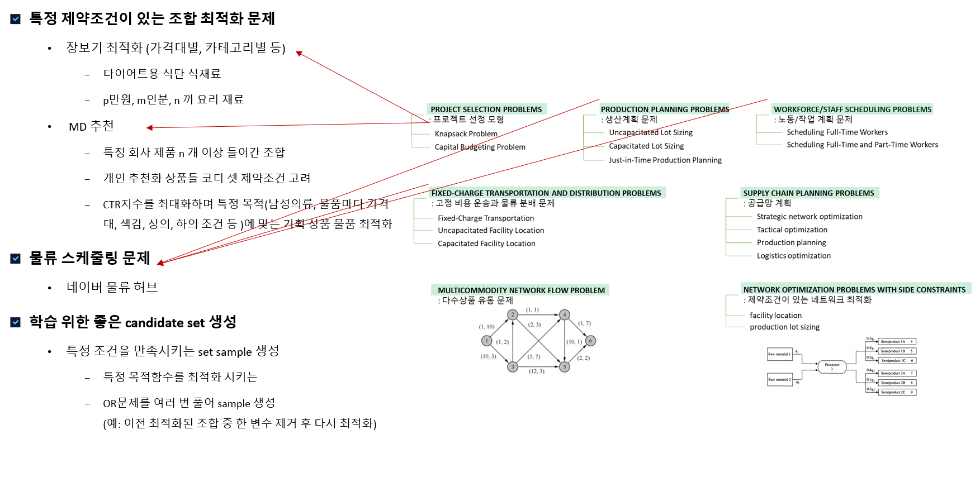
Applications

Slide 10
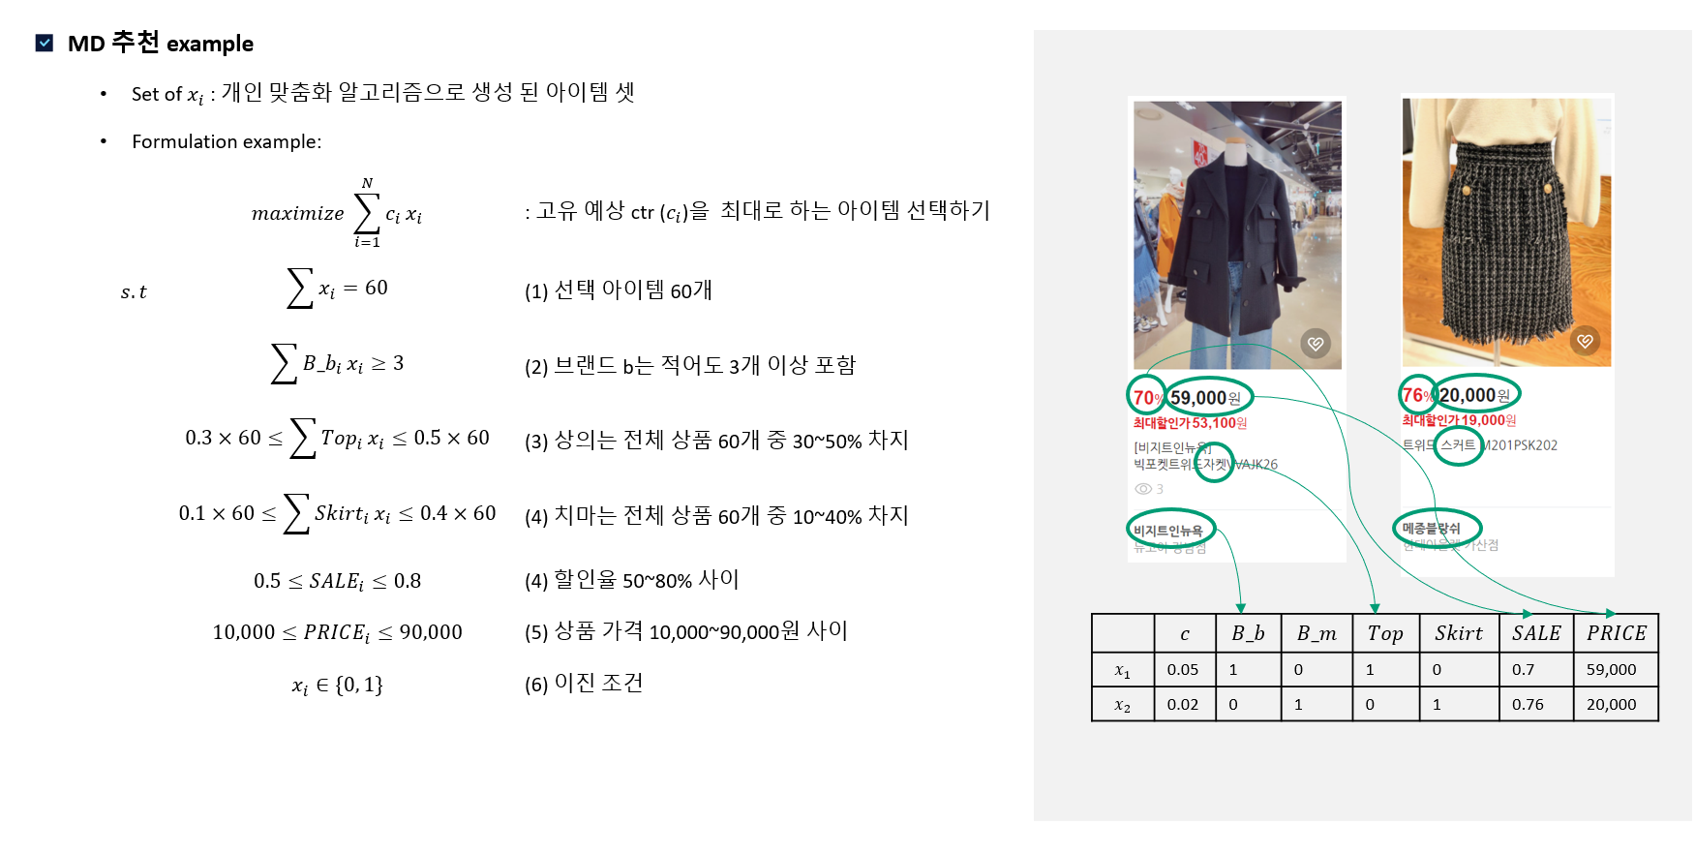
Applications (2)

Slide 11
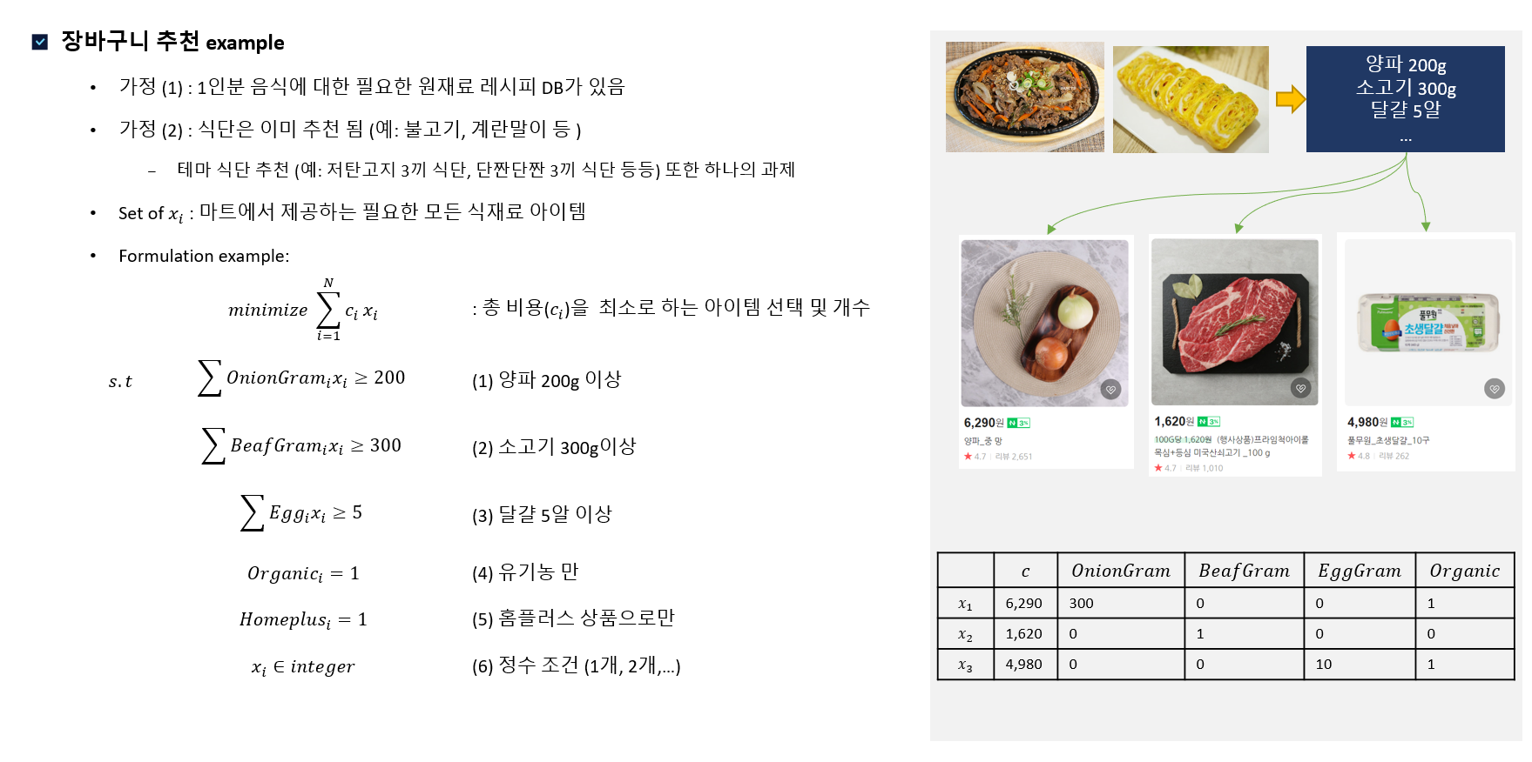
Applications (3)

Slide 12
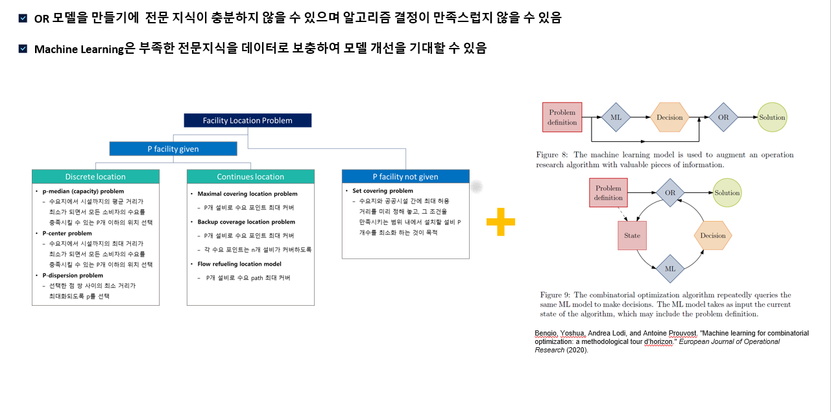
OR + ML 연구 트랜드

Slide 13
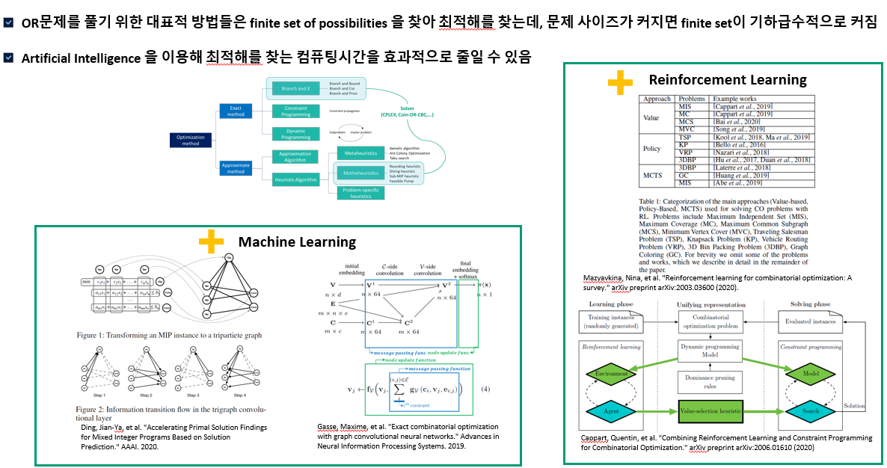
OR + ML 연구 트랜드

Slide 14
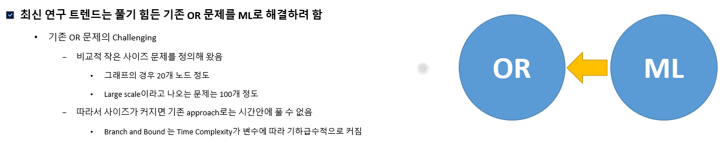
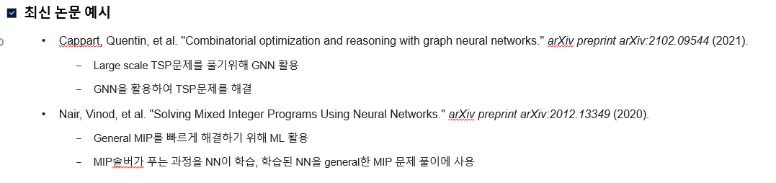
OR + ML 연구 트랜드

Slide 15
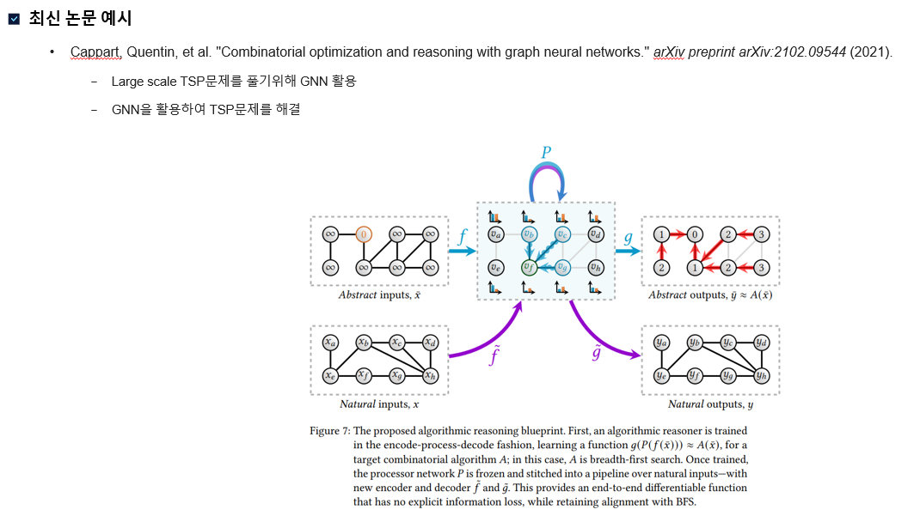
기존 논문 사례 (1)

Slide 16
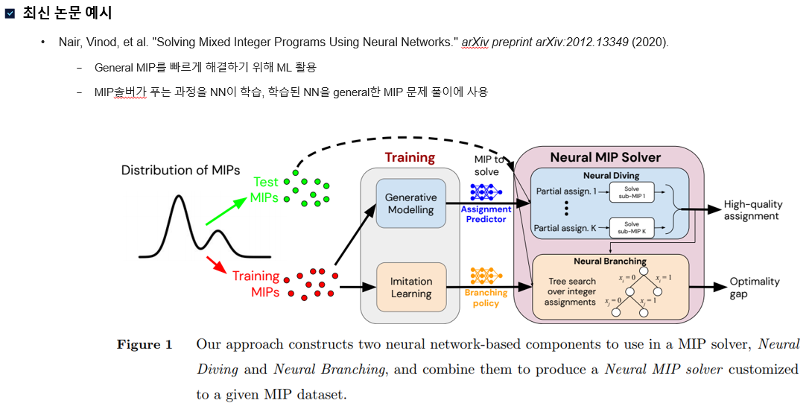
기존 논문 사례 (2)

Slide 17
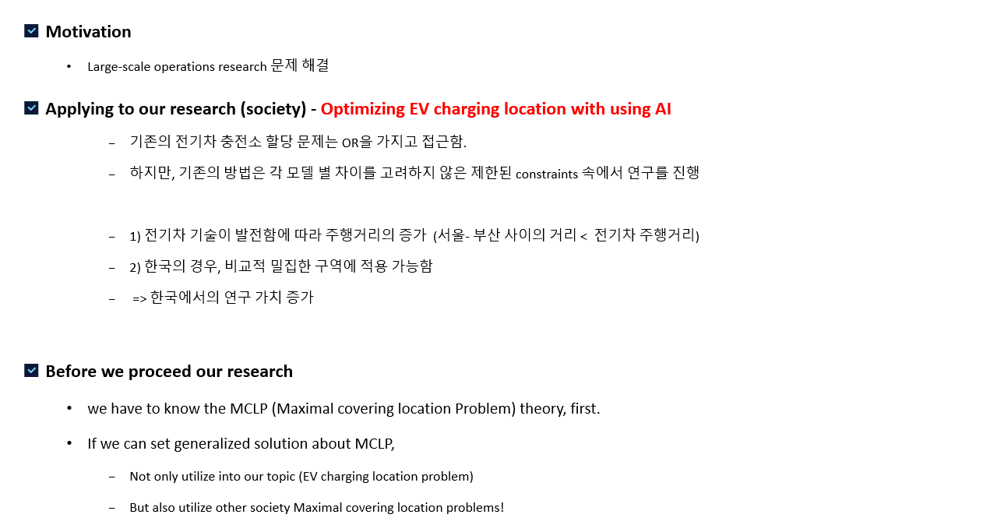
Into our research topic

Slide 18
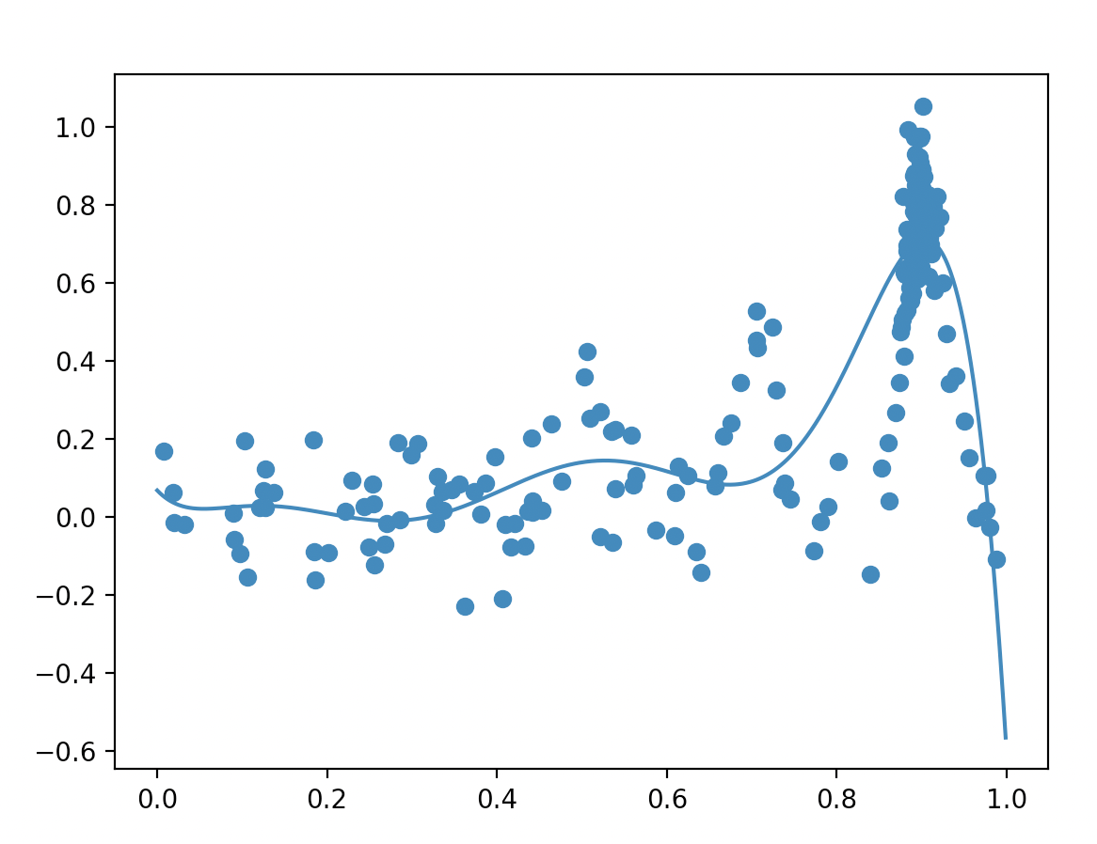
Maximal Covering Location Problem
Solve!
- 사이즈가 커지면 complexity 기하급수적으로 증가
Formulate a MCLP
Select
candidates set
Solve!
Random select
- Random select 이기 때문에 Global optimal 은 아님
Bayesian optimization
Select
candidates set
Solve!
선택가능한 complexity
Global optimal에 가까움
F(x)
Combinatorial structure [0,1]

Slide 19
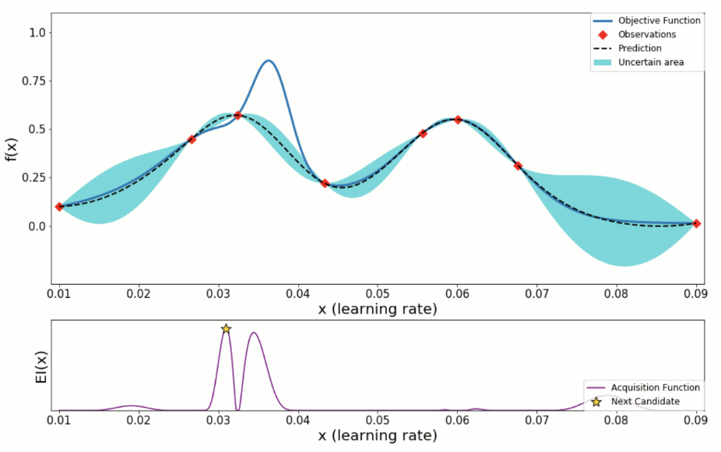
Bayesian Optimization
Overview
Optimization : finding min/max f(x) given x data set.
Bayesian : data 와 prior 을 가지고 posterior probability 를 예상 및 계산 하는 것
P(A|B) = [P(B|A)P(A)]/ P(B), 즉, given constrain (사전 정보)을 가지고 확률을 구하는 과정
Bayesian Optimization : 사전 정보를 최적화 탐색에 반영!
Stochastic model (blue area)
It has possibility, not 100% event. (GP: gaussian process)
Surrogate Model (black – dotted line)
Keep update this model until find the optimum.
What is optimum?
Objective function (called unknown black box function, blue line)
Acquisition Function
Recommend the next candidate (star point)
사진 출저 : https://wooono.tistory.com/102

Slide 20
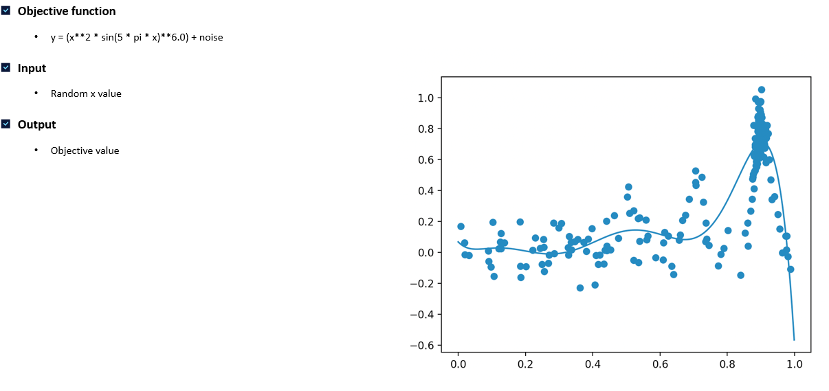
Coding example
Toy example

Slide 21
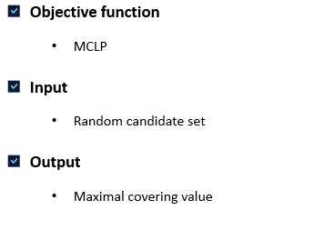
Coding example
Future work

Slide 22
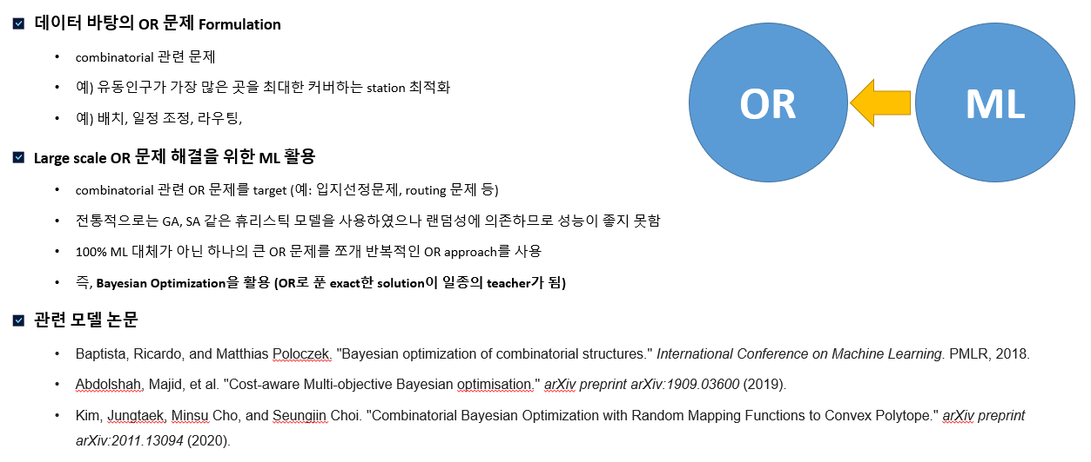
Conclusion (From summer vacation)

Slide 23
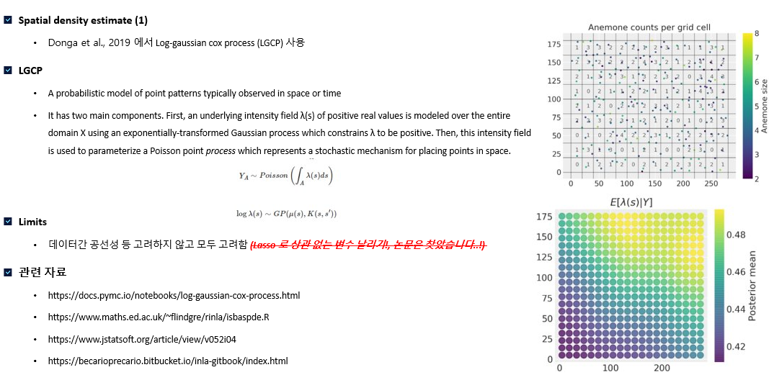
Other method candidate

Slide 24
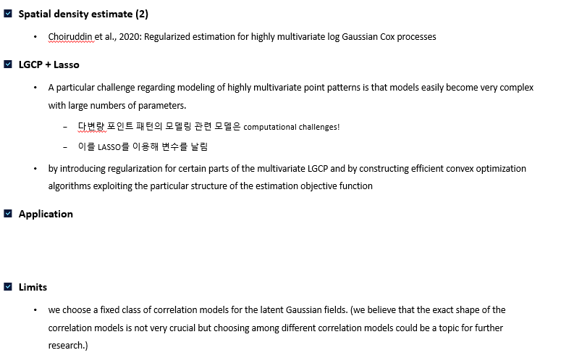
Other method candidate

Slide 25
3. Plans and Progress
Feel free to change the format and/or add more pages to highlight your contents. (자유롭게 양식 수정, 페이지 추가)
Please include the following contents:
Detailed research plans (세부 연구 계획)
Research progress chart or timeline (연구 진행상황을 볼 수 있는 차트 또는 타임라인표)
Progress chart
Tasks | March |  |  | April |  |  | May |  |  | June
논문 스터디
물품구매
코딩 구현
데이터 수집
기초 이론 다지기 (OR/ ML) TA, 권상진교수님

